Slide 1
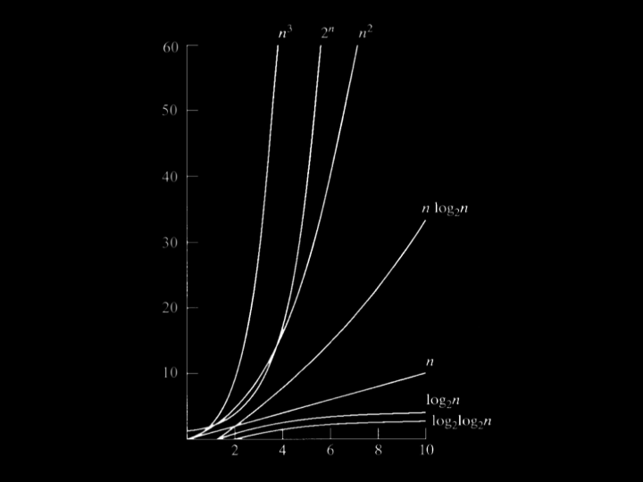

Slide 2
O(n²)
O(n log n)
O(n)
O(log n)
O(1)

Slide 3
Sorting Algorithms

Slide 4
Bubble Sort
Insertion Sort
Shell Sort
Quick Sort
Merge Sort
Heap Sort
Selection Sort

Slide 5
Insertion sort
Notes:
6 3 8 5 2 7 4 1

Slide 6
The idea of insertion sort is to build your sorted array in place, shifting elements out of the way if necessary, to make room as you go.

Slide 7
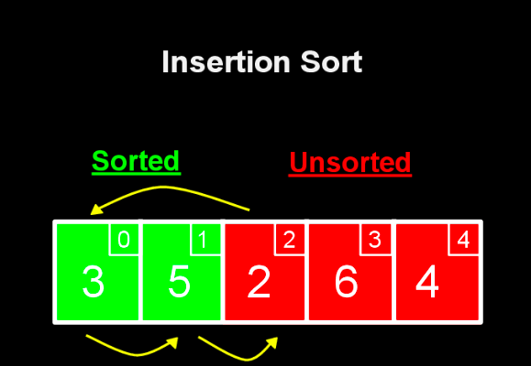

Slide 8
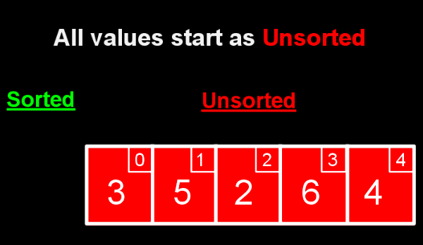

Slide 9
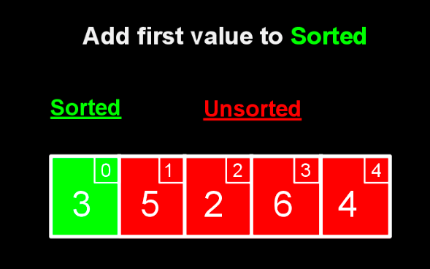

Slide 10
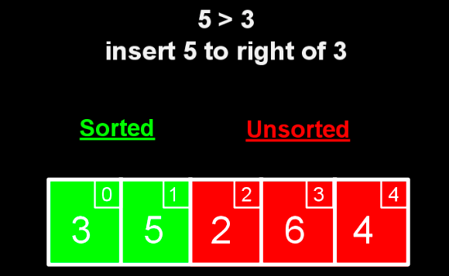

Slide 11
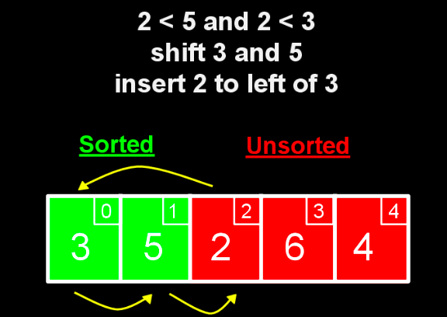

Slide 12
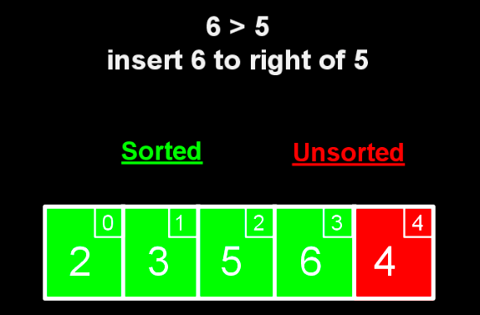

Slide 13
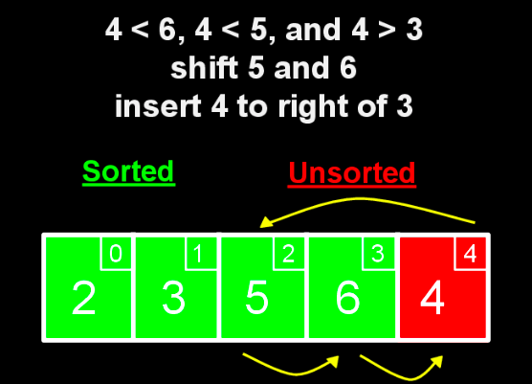

Slide 14
Pseudocode:
Call the first array of element sorted.
Repeat until all elements are sorted:
Look at the next unsorted element . Insert into sorted portion
by shifting the requisite number of elements.

Slide 15
O(n²) selection sort, bubble sort, insertion sort
O(n log n)
O(n) linear search
O(log n) binary search
O(1)

Slide 16
Ω(n²) selection sort
Ω(n log n)
Ω(n) bubble sort, insertion sort
Ω(log n)
Ω(1) linear search, binary search

